Slide 1
KMeans Clustering in 6 Dimensions to sample phase space
By: Michael Poon, Mathew Bub
June 2018

Slide 2
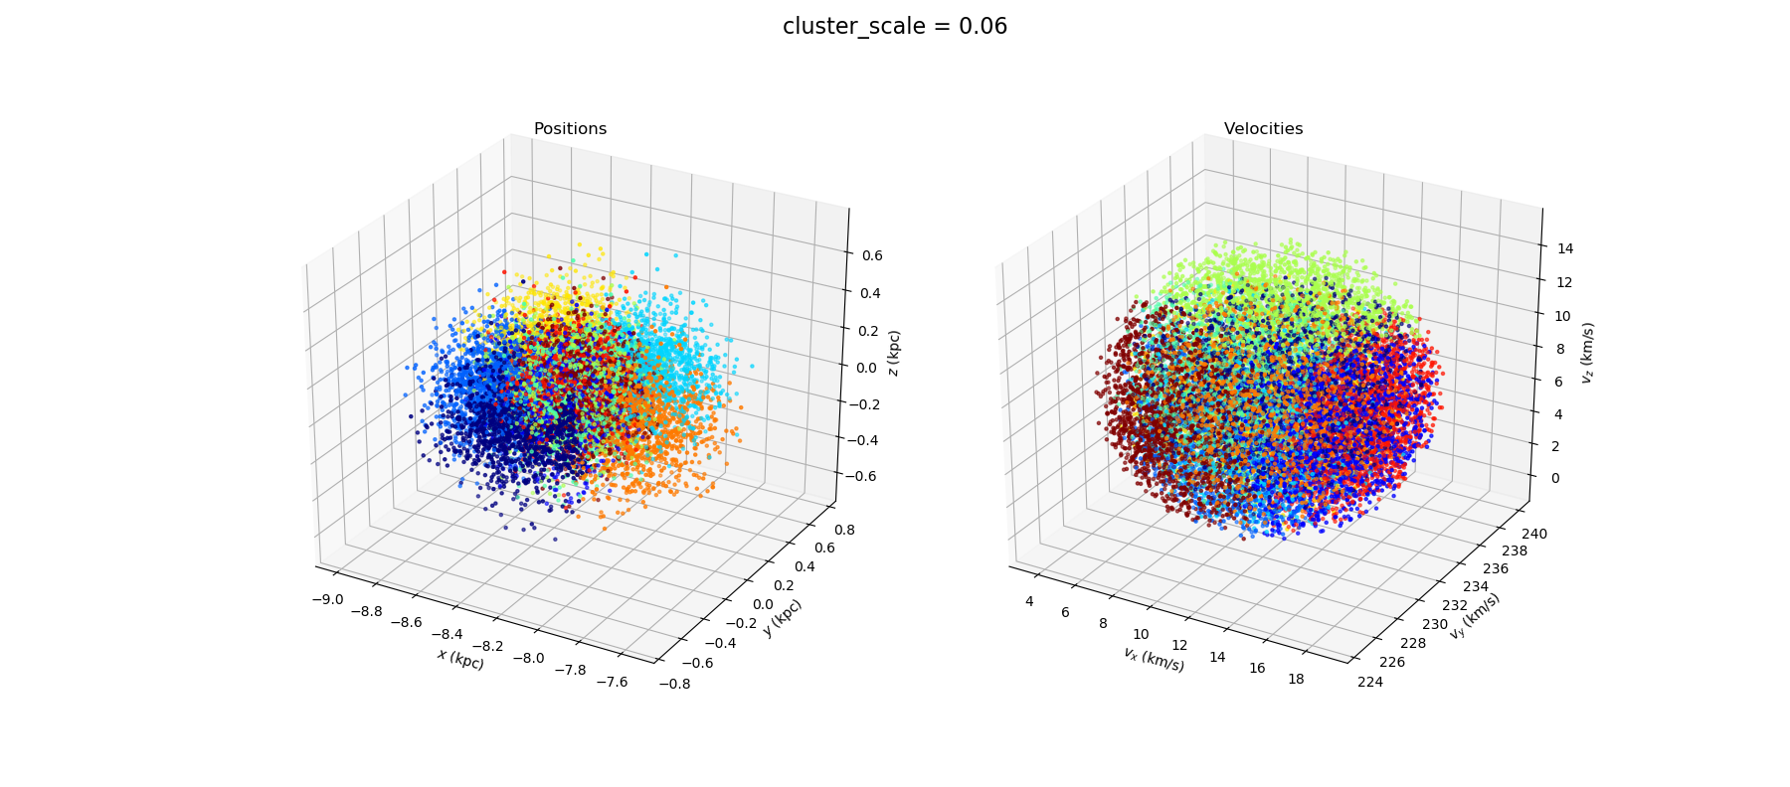
‘clustering technique to reduce 6D dataset’
By: Michael Poon, Mathew Bub
June 2018

Slide 3
Overview: Gaia DR2 RV (6D) -> main program -> 3D or 4D subspace?
Due to constraints from: Conserved (1) Energy, (2) Ang. Momentum, (3?) Mystery
Problem: main program bottleneck, reduce dataset to a reasonable sample
GOAL:
Want a reduction: 7,224,631 Stars -> quality cuts -> KMeans Clustering -> 100,000? Cluster Centers

Slide 4
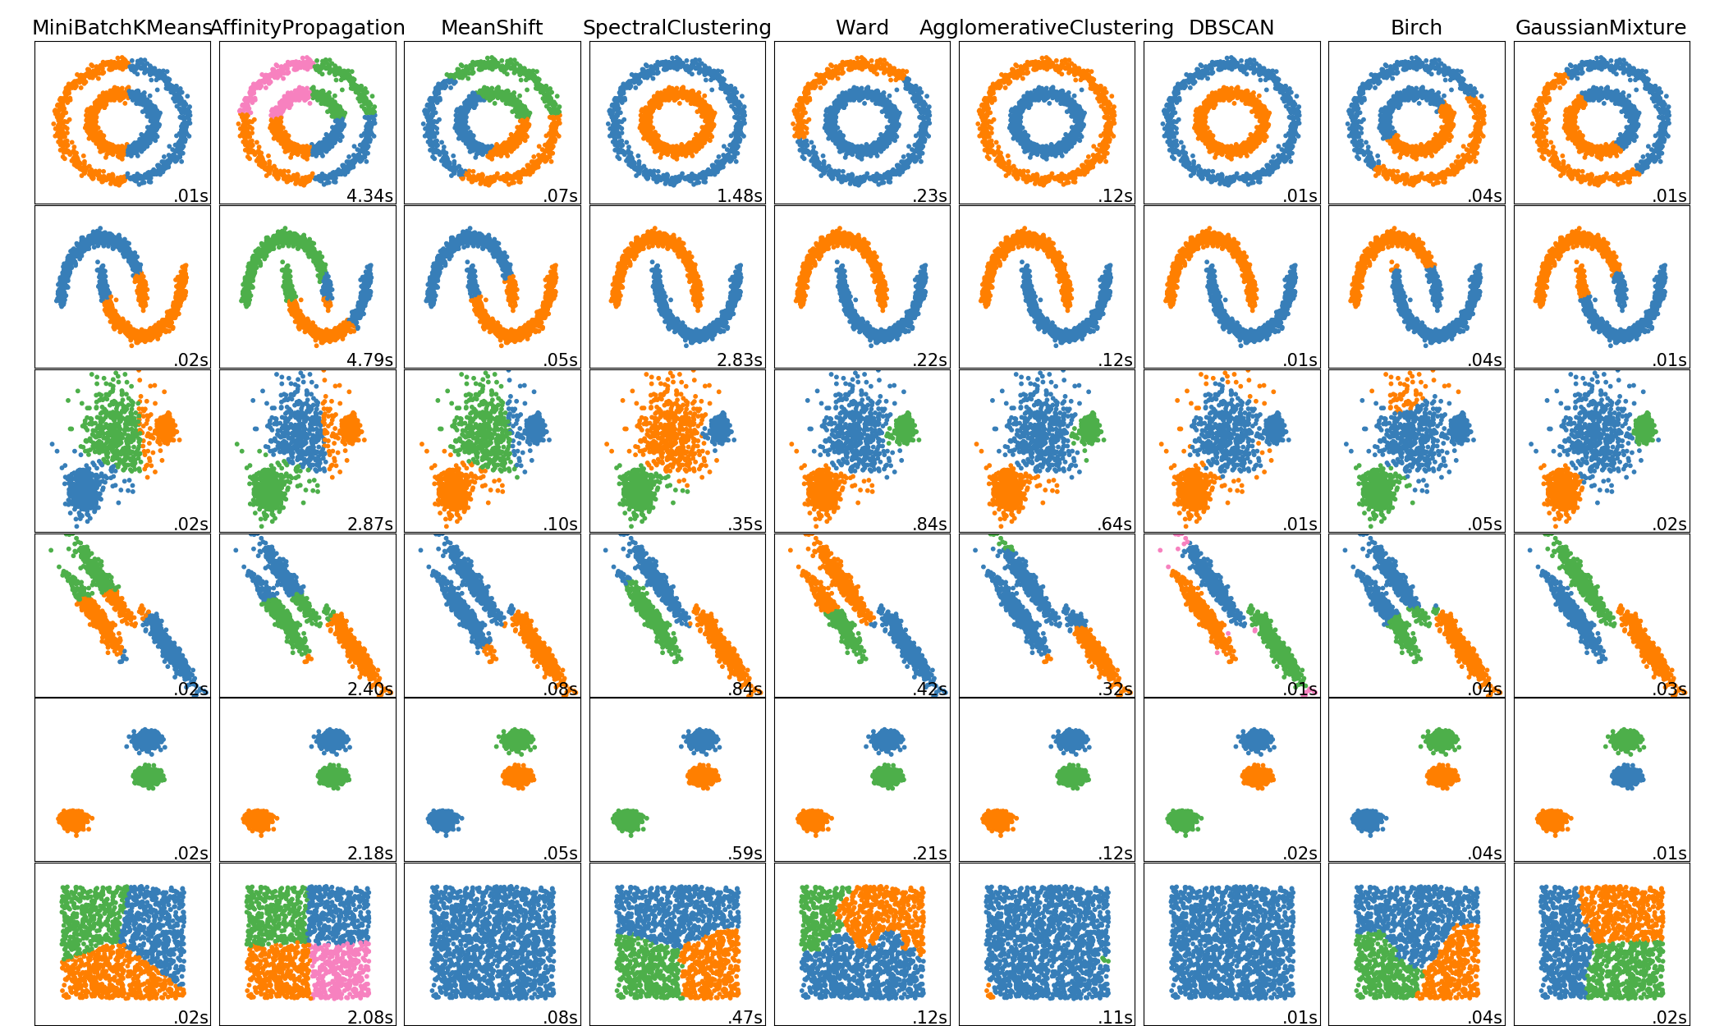
What is KMeans Clustering? -unsupervised (no “correct” solution) machine learning technique
Clusters how we want it to, and runs (relatively) fast:
Linear in Big O: O(kN), k - #iterations, N - #datapoints
scikit-learn.org

Slide 5
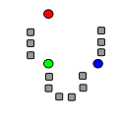
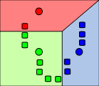
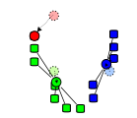
How Does KMeans Work?
Voronoi Tessellation:
1. Random Initialization
2. Voronoi Tessellation
3. Adjust “random” points
to cluster centroid
KMeans Clustering:
Circles are not datapoints, they are randomly put
wikipedia.org/wiki/K-means_clustering

Slide 6
How Does KMeans Work?
Voronoi Tessellation:
1. Random Initialization
2. Voronoi Tessellation
3. Adjust “random” points
to cluster centroid
KMeans Clustering:
Circles are not datapoints, they are randomly put
wikipedia.org/wiki/K-means_clustering

Slide 7
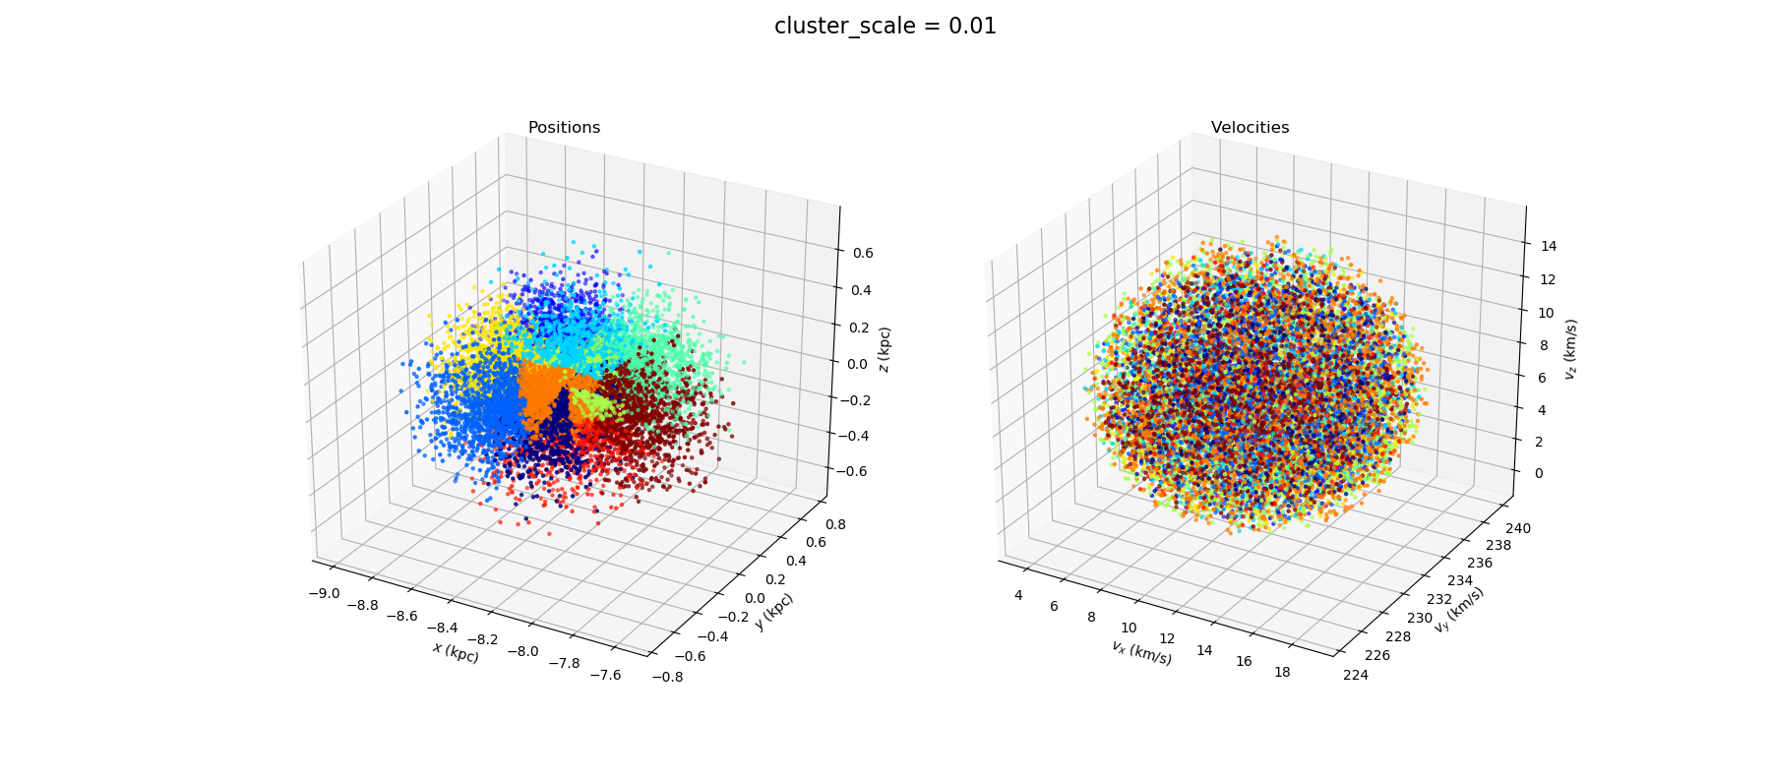
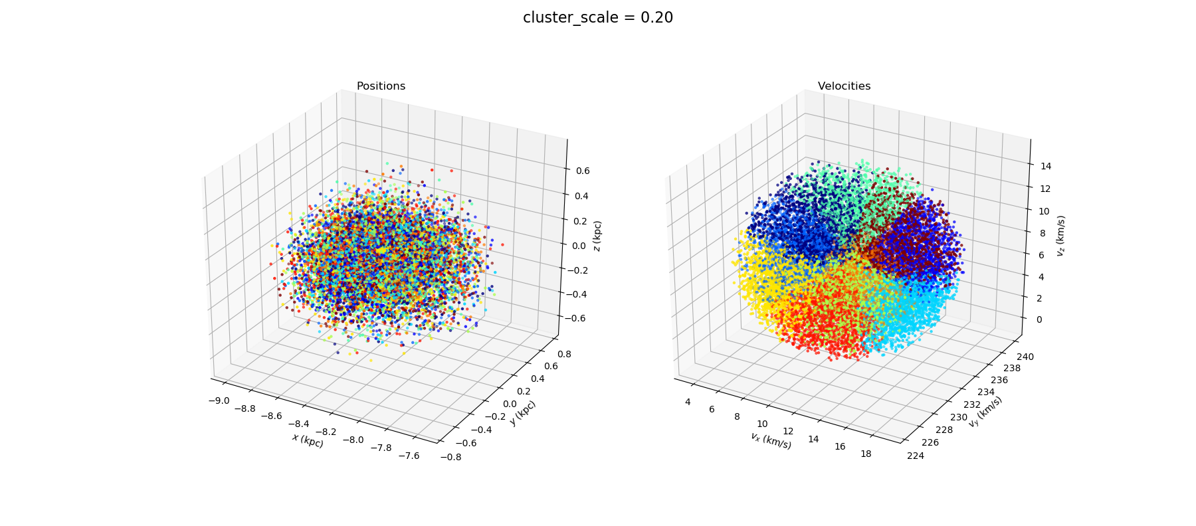
Preliminary Results: #stars: 15,000
Discuss:
Reason for cluster_scale (Normalization)
Consequences to cluster_scale
Alternatives: Standard Dev. / Interq. Range

Slide 8
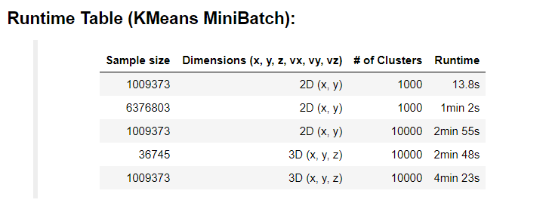
Next Steps:
What sample size should we start with? Or use all?
How many clusters should we make?
KMeans vs. KMeans MiniBatch?

